Slide 1
Passenger Screening Algorithm Challenge
Kaggle Competitions

Slide 2
Goal
Improving students' abilities in image processing and machine learning
Position in the top 50 places
Author of an academic article in the field of image processing and machine learning (depending on individual contribution)
Teamwork

Slide 3
Kaggle Timeline
December 4, 2017 - Pre-trained models and external data posting deadline.
December 4, 2017 - Entry & Team Merger deadline. You must accept the competition rules before this date in order to compete.
December 10, 2017 - Model upload & first stage deadline. This is the last day you may upload your model to be eligible for a prize.
December 11, 2017 - Second stage starts. We will release an unseen test dataset for prediction on this date.
December 15, 2017 - Final submission deadline.

Slide 4
Afeka Timeline
September 3, 2017 - Finish building a database
September 17, 2017 - Presentation of pre-processing products, models and neural networks.
October 1, 2017 - View network run configurations on an unprocessed dataset; Pre-processing finalization; Start running networks on pre-processed dataset; Feature selection
October 15, 2017 - Submit initial models.
November 15, 2017 - Improving models, features, processes and results
Nov. 30, 2017 - Final Submission

Slide 5
Dataset
This dataset contains a large number of body scans acquired by a new generation of millimeter wave scanner called the High Definition-Advanced Imaging Technology (HD-AIT) system. The competition task is to predict the probability that a given body zone (out of 17 total body zones) has a threat present.
The images in the dataset are designed to capture real scanning conditions. They are comprised of volunteers wearing different clothing types (from light summer clothes to heavy winter clothes), different body mass indices, different genders, different numbers of threats, and different types of threats. Due to restrictions on revealing the types of threats for which the TSA screens, the threats in the competition images are "inert" objects with varying material properties.

Slide 6
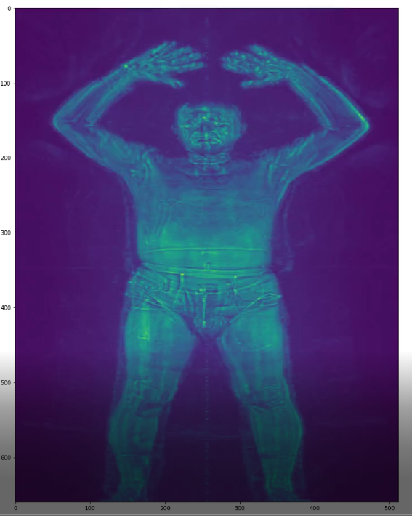
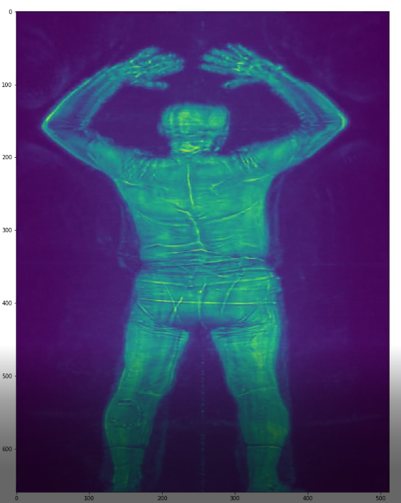
Example – open code read_image.py

Slide 7
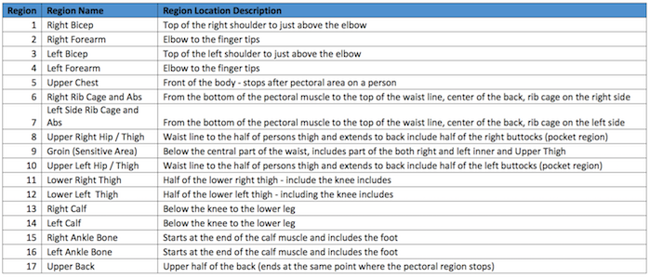
description
predict a probability for each Id and body zone
For every scan in the dataset, you will be predicting the probability that a threat is present in each of 17 body zones. A diagram of the body zone locations is available in the competition files section. The description of each zone is as follows:

Slide 8
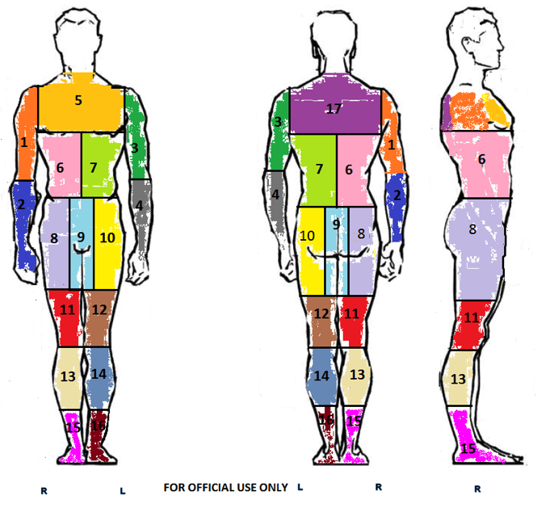
description

Slide 9
group partition

Slide 10
2D Image processing group
Generate a 2D image dataset
Segment images into 17 regions according to competition settings
Perform analysis on each region and highlight irregular sub regions
Prepare the images for training (folder organization, irregularities / edges enhancement, etc.)

Slide 11
3D Image processing group
Decode data obtained from the competition files
Building a three-dimensional model
Segment images into 17 regions according to competition settings
Prepare the images for training

Slide 12
Dataset and Pre-processing
Generate a 2D image dataset
Segment images into 17 regions according to competition settings
Indexing and pre-processing
Feature evaluation
Dataset partition and preparation

Slide 13
Deep learning
Building an infrastructure for machine learning
Build of neural networks: for 2D and 3D Dimensions:
CNN
RCNN
RNN
DNN

Slide 14
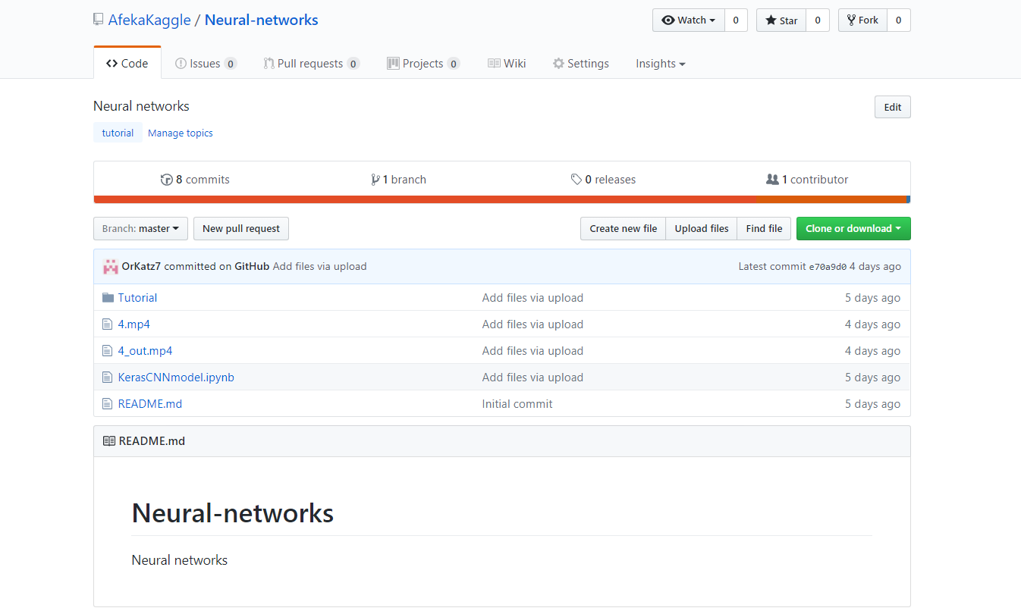
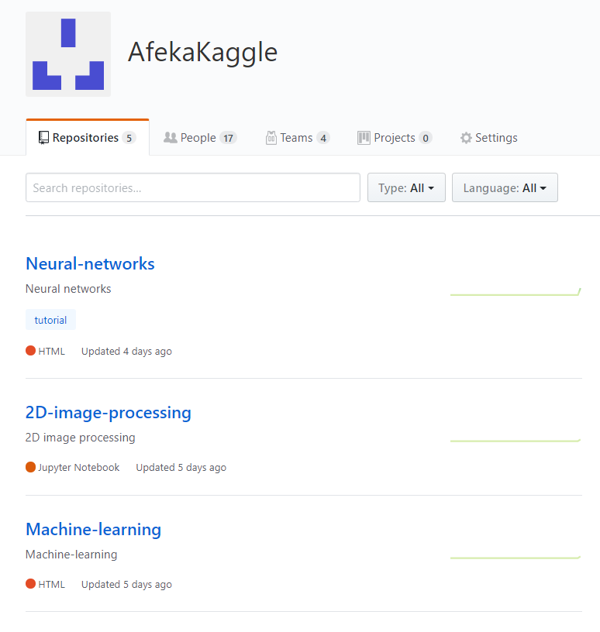
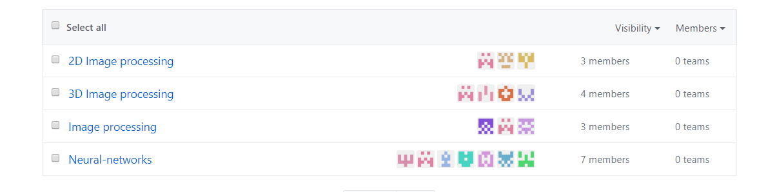
GitHub

Slide 15
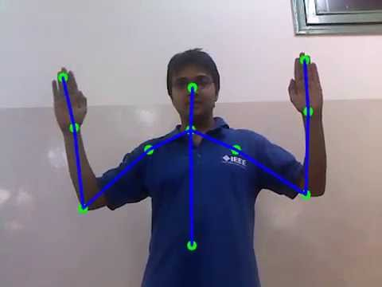
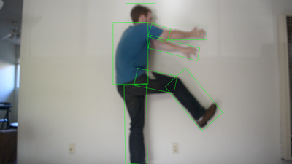
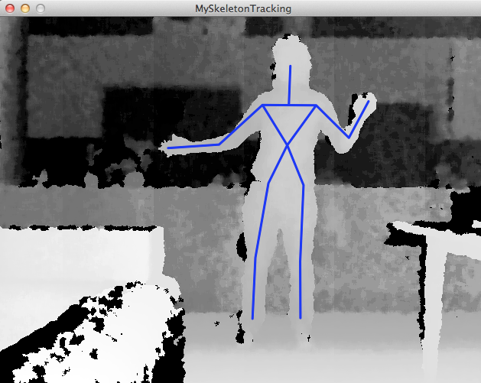
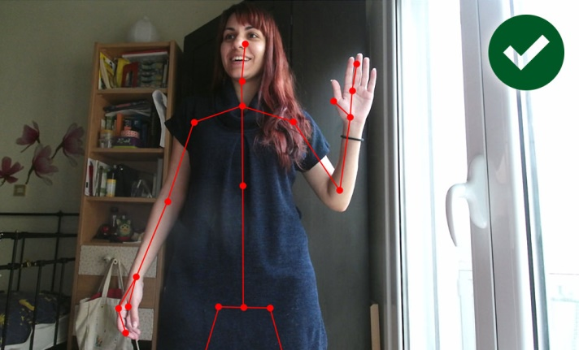
image processing - body detection

Slide 16
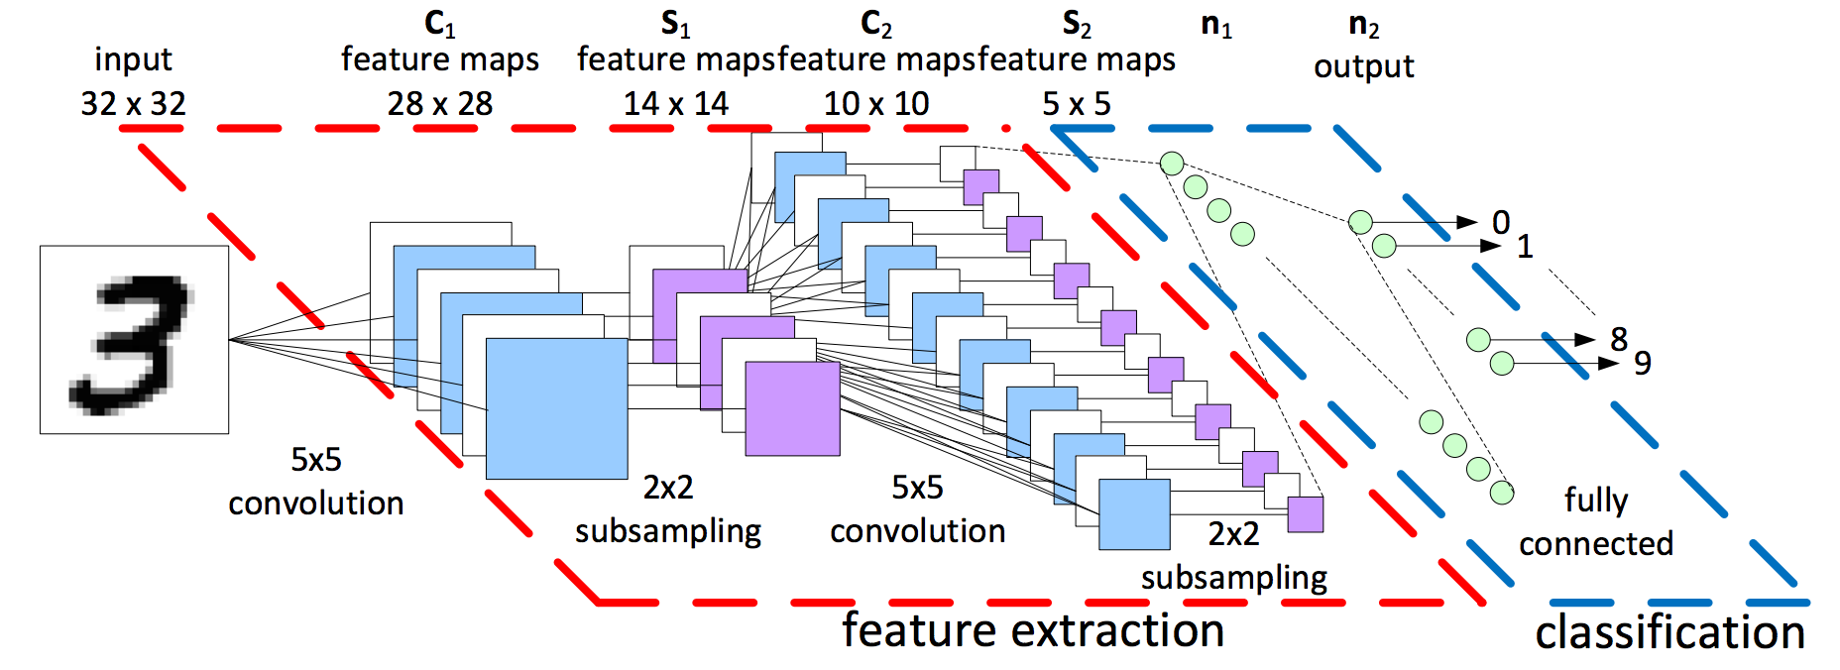
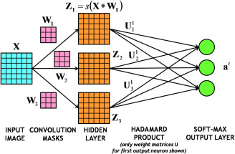
Neural Networks and Deep Learning

Slide 17
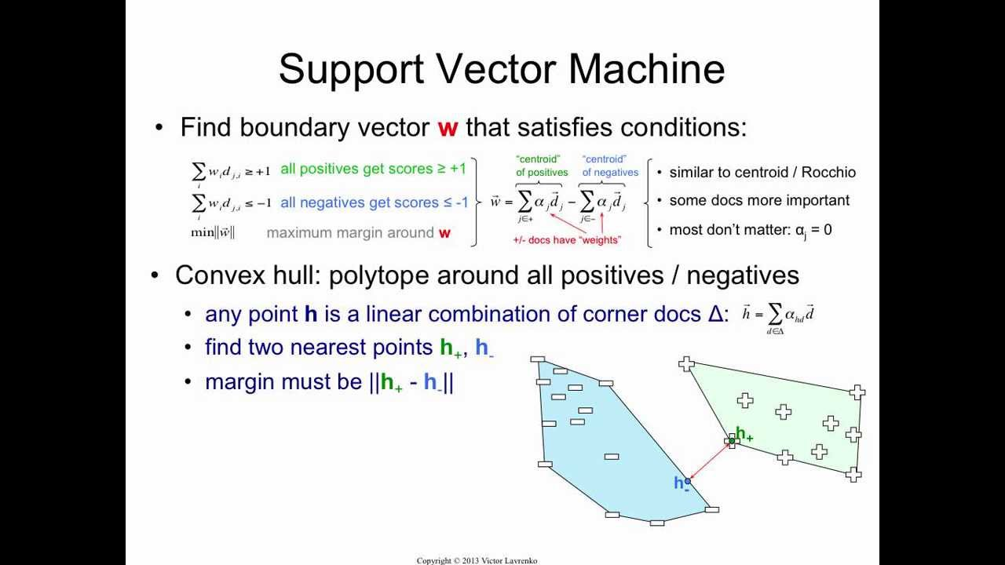
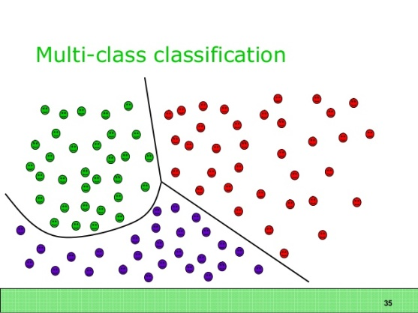
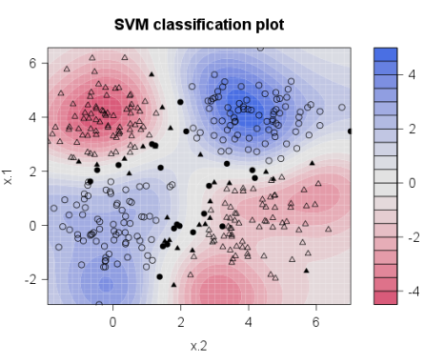
SVM Image Classification

Slide 18
Dataset Demonstration
(separate demo)

Slide 19
Good Luck

